Slide 1
Legal Framework of International Arbitration & the Role of the Seat
Simon Greenberg
September 2014
37600-6-3906

Slide 2
Article 18 Place of the Arbitration
1 The place of the arbitration shall be fixed by the Court, unless agreed upon by the parties.
2 The arbitral tribunal may, after consultation with the parties, conduct hearings and meetings at any location it considers appropriate, unless otherwise agreed by the parties.
3 The arbitral tribunal may deliberate at any location it considers appropriate.

Slide 3
Introduction and overview
Most theoretical part of the course
Very important
Legal framework includes:
At its basic: only lex arbitri (law of the seat);
More broadly: New York Convention;
And depending on your view:
the arbitration agreement.
Today will focus on the seat and its significance

Slide 4
Terminology: Seat or place of arbitration?
Terms often used interchangeably
“place” e.g. ICC Rules, Model Law & NYC
“seat” e.g. various rules in Asia (SIAC, HKIAC, ACICA…)
It has very significant legal consequences
Must not confuse with venue or location of hearings, which is simply a physical or geographic place

Slide 5
Distinction between Seat and Venue of Hearings (1/6)
Seat or place of arbitration is a legal concept
NB: an arbitration proceeding is not just the hearing. Includes arbitrator appointment, written process, etc. From a legal perspective this is all held at the seat, even if no one ever goes there:
“an arbitration proceeding does not only comprise of the oral hearing and the submission [to arbitration]. It encompasses an entire process, commencing from the appointment of the arbitrator or arbitrators to the rendering of the final award”¹
¹ PT Garuda Indonesia v Birgen Air [2002] 1 SLR 393 at 402 (Singapore Court of Appeal).

Slide 6
Distinction between Seat and Venue of Hearings (2/6)
Hearings and meetings may be held at any convenient location (see ICC Art 18(2); ML Art 20(2)):
“the arbitral tribunal may, unless otherwise agreed by the parties, meet at any place it considers appropriate for consultation among its members, for hearing witnesses, experts of the parties, or for inspection of goods, other property or documents”.
In practice, hearings and meetings are usually held at the seat.
Angela Raguz v Rebecca Sullivan. 2000 Sydney Olympic Games. Seat Geneva, hearings in Sydney. Court of Appeal:
“Commentators have pointed out that Article 20 [of the Model Law] makes sense when it is understood that there is a vital distinction between the so-called place (or seat) of arbitration and the place or places where the arbitrators may hold hearings, consultations… The common law recognises this distinction…
² (2000) 50 NSWLR 236, paras 97, 102, 103.

Slide 7
Distinction between Seat and Venue of Hearings (3/6)
(…) In our opinion the legislature was concerned with the legal place of the arbitration, not the physical place of the arbitration.
…Indeed, it may be convenient to conduct hearings in more than one physical location in the course of a particular dispute. It is, in our opinion, likely that the legislature intended to allow parties to commercial agreements to select a single legal place of arbitration and to leave the choice of the physical location of hearings to the felt necessities of a specific dispute.”
Questions:
- What powers do the courts at the venue (place of hearings) have?
- What mandatory rules do arbitrators have to comply with at the venue?

Slide 8
Distinction between Seat and Venue of Hearings (4/6)
Holding the hearings elsewhere cannot change the legal seat.
Singapore Court of Appeal in PT Garuda Indonesia v Birgen Air. Court of Appeal observed³:
“It should be apparent from art 20 [Model Law] that there is a distinction between ‘place of arbitration’ and the place where the arbitral tribunal carries on hearing witnesses, experts or the parties, namely the ‘venue of the hearing’. Where parties have agreed on the place of arbitration, it does not change even though the tribunal may need to hear witnesses or do any other things in relation to the arbitration in a different location.”
³ PT Garuda Indonesia v Birgen Air [2002] 1 SLR 393, at 399. See also the discussion of changing the seat at Section 6.3.

Slide 9
Distinction between Seat and Venue of Hearings (5/6)
Singapore Court of Appeal rejected an argument by PT Garuda that the parties had changed the place of arbitration from Jakarta to Singapore by holding their hearings in Singapore.
Exercise: Here is an arbitration clause. Is the seat of arbitration specified?
Any and all disputes arising from this contract shall be finally settled by arbitration held in Hong Kong under the Rules of Arbitration of the International Chamber of Commerce by one or more arbitrators appointed in accordance with the said Rules of Arbitration.

Slide 10
Distinction between Seat and Venue of Hearings (6/6)
And which is the seat in this one?
Any and all disputes arising from this contract shall be finally settled by arbitration held in Hong Kong under the Rules of Arbitration of the International Chamber of Commerce by one or more arbitrators appointed in accordance with the said Rules of Arbitration. The place of arbitration shall be Tokyo.
What about the other location?
What happens if an arbitration agreement does not designate the seat? Factors to consider?

Slide 11
Lex arbitri, Arbitral Procedural Law and Arbitration Rules
Terms concerning procedural legality in IA
‘lex arbitri’ – Automatically law of seat. E.g. right to arbitrate, objective arbitrability, due process and independence standards. Setting aside award.
‘procedural law’ provides process. E.g. fallback provisions for arbitrator appointment, challenges, etc. Details of due process etc. (usually in same law as lex arbitri)
‘procedural rules’ or ‘arbitration rules’. Rules concerning conduct of arbitration adopted by agreement. (Can also mention arb. agreement)

Slide 12
Lex arbitri, Arbitral Procedural Law and Arbitration Rules (2/3)
Lex arbitri and procedural law are law, rules apply contractually
Although rare in practice it is possible to have a procedural law different from the lex arbitri. Very problematic and to be avoided.
There is often overlap between procedural laws and arbitration rules. E.g. ML and ICC Rules. Which prevails (e.g. on procedure for appointment, challenge, time limits)?
Procedural law will regulate additional matters. E.g. extent and nature of judicial supervision and involvement (ML Arts 5, 8)

Slide 13
Lex arbitri, Arbitral Procedural Law and Arbitration Rules
Procedural pyramid
Arb Agt
Arbitration Rules
Procedural Laws
Lex Arbitri
Life of the arbitration

Slide 14
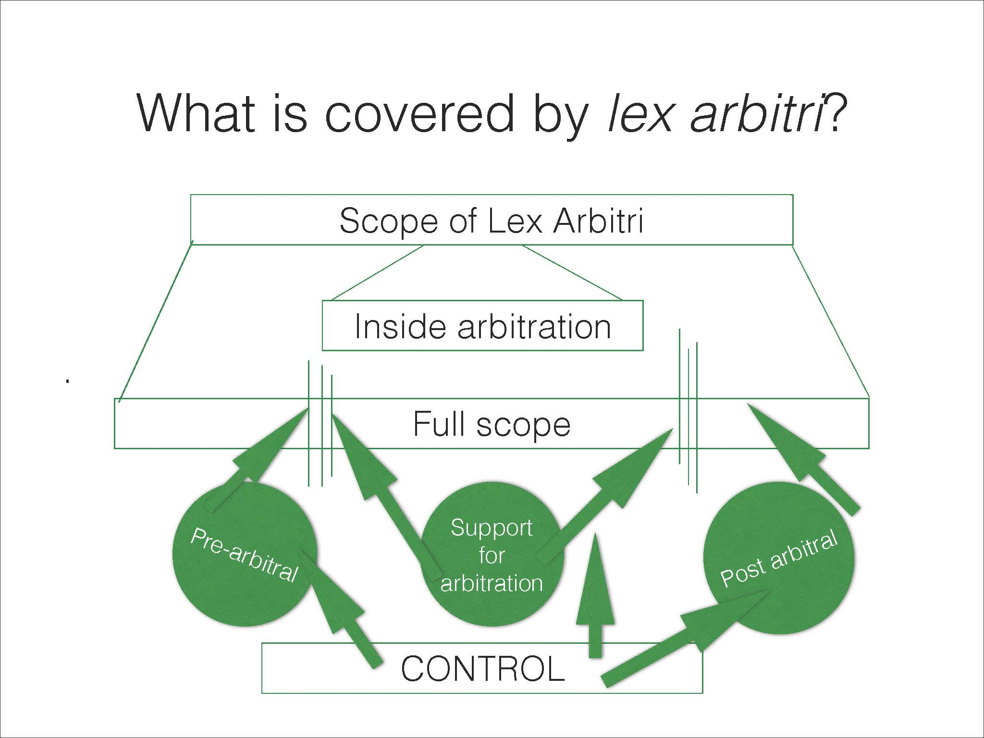
What is covered by lex arbitri?

Slide 15
Content of typical Arbitration Law
Arbitration laws typically regulate:
Right to arbitrate
Right to choose procedure
Competence-competence (not arbitration Rules)
Formal validity of arbitration agreements
default provisions on appointment/ removal of arbitrators
fundamental (mandatory) procedural rules, e.g. of arbitrator independence, procedural fairness
Apply over and above institutional rules
formal and substantive requirements for awards
recourse against arbitral awards
Is it possible to appeal? (NZ, ICDR, Israel, UK)

Slide 16
Choosing foreign procedural law
18. DISPUTES AND ARBITRATION.
[…] proceedings in such arbitration shall be conducted in English. The venue of the arbitration proceedings shall be in London. The arbitrators may (but shall not be obliged to) award costs and reasonable expenses (including reasonable-fees of counsel) to the Party (ies) that substantially prevail on merit. The provisions of Indian Arbitration and Conciliation Act, 1996 shall apply.
Questions: Where is the seat?
- Does the Indian proc law apply like arbitral rules?
- Which courts deal with setting aside? Which standards do they apply of due process, independence, construction of arb. agreement?
Enercon India v. Enercon GMBH [Civ. App. 2086/7 of 2014] Indian SC

Slide 17
Delocalised & Traditional Views of Arbitration (1/6)
Legal theories to describe the degree of connection between an arbitration and the seat of arbitration
Traditional view:
International arbitration proceedings must be attached to a seat, as this is how arbitration gains legal recognition
Relationship with notion of state sovereignty: right of a state to regulate all conduct taking place in its territory
No truly “international” arbitration as it is always connected to a seat, and thus integrated into that country’s laws

Slide 18
Delocalised & Traditional Views of Arbitration (2/6)
Francis Mann:
‘Is not every activity occurring on the territory of a State necessarily subject to its jurisdiction? Is it not for such State to say whether and in what manner arbitrators are assimilated to judges and, like them, subject to the law? Various States may give various answers to the question, but that each of them has the right to, and does, answer it according to its own discretion cannot be doubted.’
Markham Ball:
‘Arbitration is not a separate, free-standing system of justice. It is a system established and regulated pursuant to law, and it necessarily bears a close relationship to a nation’s courts and judicial system.’

Slide 19
Delocalised & Traditional Views of Arbitration (3/6)
Delocalised or ‘contractual’ view:
no link needed between seat of arbitration and arbitration proceedings
Arbitration gains recognition and existence from parties’ contract
So arbitration proceedings must be free from any interference or control from local courts.
Only enforcing courts may exercise control over an award, as a condition to recognising and enforcing it.
Before enforcement, an award need not enter into a domestic legal order

Slide 20
Delocalised & Traditional Views of Arbitration (4/6)
Jan Paulsson: ‘Delocalisation of International Commercial Arbitration: When and Why it Matters’⁵:
“the delocalised award is not thought to be independent of any legal order. Rather, the point is that a delocalised award may be accepted by the legal order of an enforcement jurisdiction although it is independent from the legal order of its country of origin.”
The focus on the enforcing jurisdiction made sense in early 1980’s, given the disparity in arbitration laws (lex arbitri). NYC was harmonised but not lex arbitri. Less relevant today due to ML.
Example: a certain mandatory law exists in the lex arbitri but does not exist in the jurisdiction of the law governing the contract.
Should that law be applied?
⁵ J Paulsson, ‘Delocalisation of International Commercial Arbitration: When and Why it Matters’, (1983) 32 International and Comparative Law Quarterly 53.

Slide 21
Delocalised & Traditional Views of Arbitration (5/6)
Hilmarton v OTV⁶ and Chromalloy v Egypt⁷. Arbitral awards that had been set aside at the seat were enforced elsewhere. (see Art V1 NYC “may”)
Hilmarton: Seat in Switzerland. AT found contract unenforceable because it contravened Algerian laws on bribery and corruption. Upon Hilmarton’s application, the Swiss Federal Supreme Court set aside the award, finding that the arbitrators ought not to have considered Algerian law.
But French courts – in decisions ultimately appealed to and confirmed by France’s highest court – recognised the award. Cour de Cassation controversially observed⁸:
⁶ Cass. le civ., Mar. 23, 1994, 1994 Revue de L’Arbitrage. 327 (French Cour de Cassation).
⁷ 939 F Supp 907 (DDC 1996) (US District Court of the District of Columbia).
⁸ Authors’ translation from French. Cour de Cassation decision of 23 March 1993. See Revue de L’Arbitrage, 1994.327, note Ch. Jarrosson; Bull civ, I, no. 104, p. 79; Journal du droit international (Clunet), 1994.701, note E Gaillard.

Slide 22
Delocalised & Traditional Views of Arbitration (6/6)
“the award made in Switzerland was an international award which was not integrated into the legal system of that State, meaning that the award’s existence remained established despite its having been set aside and that its recognition was not contrary to international public policy”
Both decisions were based on the notion that where an award contravenes the public policy of the seat of arbitration but not that of the enforcement country, the award can still be enforced.

Slide 23
Delocalisation in Practice: Legal Provisions (1/5)
Bank Mellat v Helliniki Techniki, 1984, England, Justice Kerr:
“despite suggestions to the contrary by some learned writers under other systems, our jurisprudence does not recognise the concept of arbitral procedures floating in the transnational firmament, unconnected with a municipal system of law”
Consider whether delocalisation exists in NYC and lex arbitri.
Article V(2) NYC:
“recognition and enforcement of an arbitral award may also be refused if the competent authority in the country where recognition and enforcement is sought finds that (a) the subject matter of the difference is not capable of settlement by arbitration under the law of that country or (b) the recognition or enforcement of the award would be contrary to the public policy of that country.”
‘that country’ is where enforcement is sought. Could be said to support delocalisation; but still this only concerns enforcement

Slide 24
Delocalisation in Practice: Legal Provisions (2/5)
Article V(1) NYC:
‘Recognition and enforcement of the award may be refused [upon] proof that:
a) the [arbitration] agreement is not valid under the law to which the parties have subjected it or, failing any indication thereon, under the law of the country where the award was made; or . . .
d) The composition of the arbitral authority or the arbitral procedure was not in accordance with the agreement of the parties, or, failing such agreement, was not in accordance with the law of the country where the arbitration took place; or . . .
e) The award has . . . been set aside or suspended by a competent authority of the country in which, or under the law of which, that award was made’.
Article V(1)(a) and (d) give primacy to the parties’ agreement (delocalisation), yet then refer to law of the seat.
NB: the discretion (“may”) supports delocalisation: no requirement to defer to decisions of the courts of the seat

Slide 25
Delocalisation in Practice: Legal Provisions (3/5)
Barrier to delocalisation in Article I NYC:
‘This Convention shall apply to the recognition and enforcement of arbitral awards made in the territory of a state other than the state where the recognition and enforcement of such awards are sought.’
Examples of pure delocalisation in lex arbitri: Former laws in Malaysia and Belgium which did not allow for setting aside proceedings at the seat (in Malaysia if the KLRCA rules were chosen).
In practice, the ML and all modern arbitration laws allow for only very limited court involvement, yet there is still some connection to the seat (see eg Art 34 (especially 34(2)(b)) and 16(3) ML).

Slide 26
Delocalisation in Practice: Legal Provisions (4/5)
Some courts (e.g. India & Indonesia) have purported to set aside foreign awards despite in India’s case having adopted the ML.
ICSID arbitration is delocalised. NO involvement of domestic courts (except at the end to assist in enforcement).

Slide 27
Delocalisation in Practice: Legal Provisions (5/5)
Conclusion on delocalisation
Does not exist in practice in pure form (apart from ICSID).
However the debate has made arbitration laws light on court supervision, which is a trend likely to continue (eg new French arbitration law allowing parties to opt out of setting aside grounds).

Slide 28
Designation of Seat: how is it chosen?
By agreement. Any words indicating choice. Eg ‘the seat of arbitration will be X’.
Other language, even vague, will usually suffice unless there is conflicting locations in the clause. Careful not to confuse with the location or venue for hearings
Failing agreement, default mechanism under rules or procedural law. Eg ICC Art 18(1); ML Art 20.
ICC: seats of arbitration 2013 - literally all over the world:
Places of arbitration 2013: 63 countries, 104 different cities
European cities: 79 % (Paris 118, London 70, Geneva 56)
Asian cities: 11,84% (Hong Kong 14)
11.5% of places fixed by the Court and the rest (88.5%) by the parties

Slide 29
Factors to consider in choosing a Seat of Arbitration
Laws are most important. Party to NYC, modern accessible arbitration law, arbitration friendly courts.
Geographic (for all players) and infrastructure convenience are second most important criteria.
Neutrality. You can choose a seat that is completely neutral, i.e. no connection to any party or to the dispute. In practice there is often zero connection.
Classic, safe, popular seats: Singapore, HK, Paris, Zurich, Geneva, Vienna, New York. London, ok, but some risks.

Slide 30
Changing the Seat of Arbitration
Can be changed only with party agreement. Should consult the Tribunal as well
Changing seat can bring (sometimes unexpected) legal consequences: important decision. Much better to change location of hearings if a problem arises
If no party agreement, it is nearly impossible to have it changed. Perhaps if it was fixed by an institution. But not if it was initially agreed by the parties
Justice Allsop, Australian Federal Court: ‘[g]enerally speaking, a party, having bargained for a place of dispute resolution, should not have to go into its private reasons for agreeing to that place and for not wanting to litigate elsewhere’¹¹.
The chosen seat could be considered a condition of the consent to arbitrate. A change would mean parties’ agreed procedure not followed (see e.g. Article 34(2) ML)
¹¹ Incitec Ltd v Alkimos Shipping (2006) ALR 558, at p. 566.

Slide 31
Popular Places of Arbitration
2013: ICC arbitrations were seated in 104 cities in 63 countries
Most popular places of arbitration 2006-2013:
Place | 2006 | 2007 | 2008 | 2009 | 2010 | 2011 | 2012 | 2013
Paris | 101 | 108 | 86 | 113 | 124 | 111 | 100 | 118
London | 40 | 58 | 61 | 73 | 70 | 62 | 71 | 70
Geneva | 49 | 56 | 43 | 62 | 48 | 53 | 62 | 56
Zurich | 41 | 36 | 32 | 50 | 30 | 40 | 48 | 34
Singapore | 12 | 17 | 31 | 38 | 24 | 24 | 36 | 33

Slide 32
The end
Questions?
Exercise?

Slide 33
Legal Framework of International Arbitration & the Role of the Seat

